Slide 1

MVA PROJECT: Banking
Andreja Andrejic, David Candela, Nayara Costa, Julie Oppedal, Alexandros Tremopoulos

Slide 2
1.Introduction

Slide 3

Data
The Bank Marketing dataset compiles call information from a Portuguese banking institution with the objective of predicting whether a client will subscribe to a term deposit.
- 4521 records in the sample (bank.csv)
- 17 total variables

Slide 4
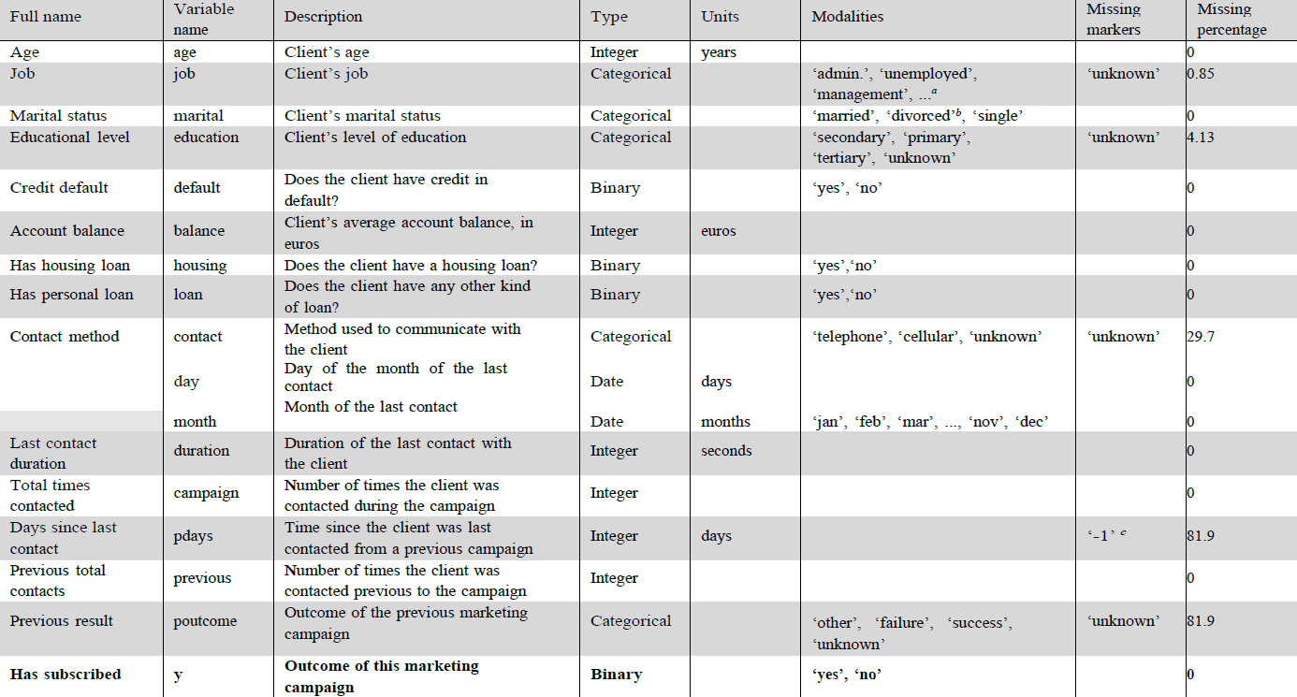

Slide 5
2.1 Preprocessing (Missing Values)

Slide 6
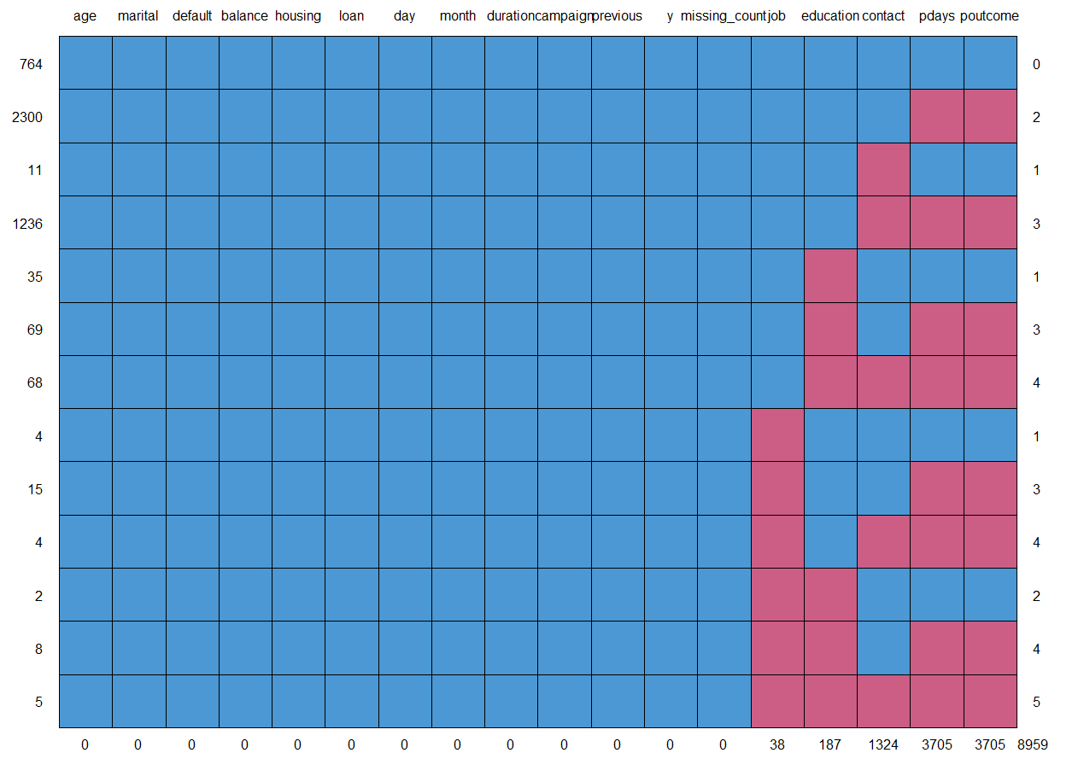
Identification
Variable | Missing Count | Percentage
pdays | 3705 | 81.95%
poutcome | 3705 | 81.95%
contact | 1324 | 29.28%
education | 187 | 4.13%
job | 38 | 0.84%
4 categorical -> ‘unknown’
1 numeric -> -1 (‘pdays’)
Missing in all cells ~11.65%
Little’s test, MCAR?
Pdays not
‘pdays’ and ‘poutcome’ together. ‘contact’ (99%) Not MNAR.
‘job’ and ‘education’ out of intention??

Slide 7
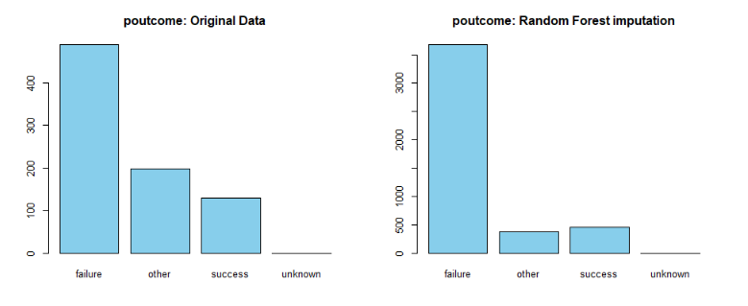
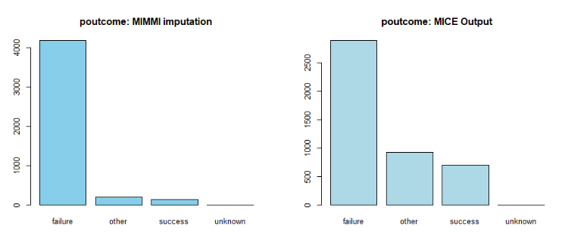
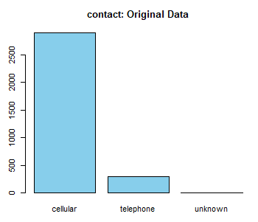
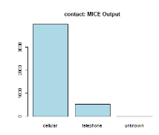
Imputation
Imputation methods: KNN, MIMMI, Random Forest, MICE
‘pdays’. MICE best -> quartiles and mean closest to original data among them
‘poutcome’. MICE
‘contact’. MICE.
Original : cellular ->90,58% , telephone -> 9.41%.
MICE. Original: cellular ->88,38%, telephone -> 11.6%

Slide 8
Imputation
IMPORTANT plot twist.
Variable ‘previous’ -> nof times client was contacted previous to the campaign.
Tested and saw that when 0, ‘pdays’ -> -1 and ‘poutcome’ -> ‘unkown’.
Reasonable. If the bank has never contacted the client before -> no passed days since and not previous outcome. Thus -1 and ‘unknown’.
Do not impute. ‘pdays’ dropped -> almost 82% with -1.
Impute only ‘contact’. From scratch. Again MICE.
Original : cellular ->90,58% , telephone -> 9.41%.
MICE. Original: cellular ->90,68%, telephone -> 9.31%

Slide 9
2.2 Preprocessing (Outliers)

Slide 10
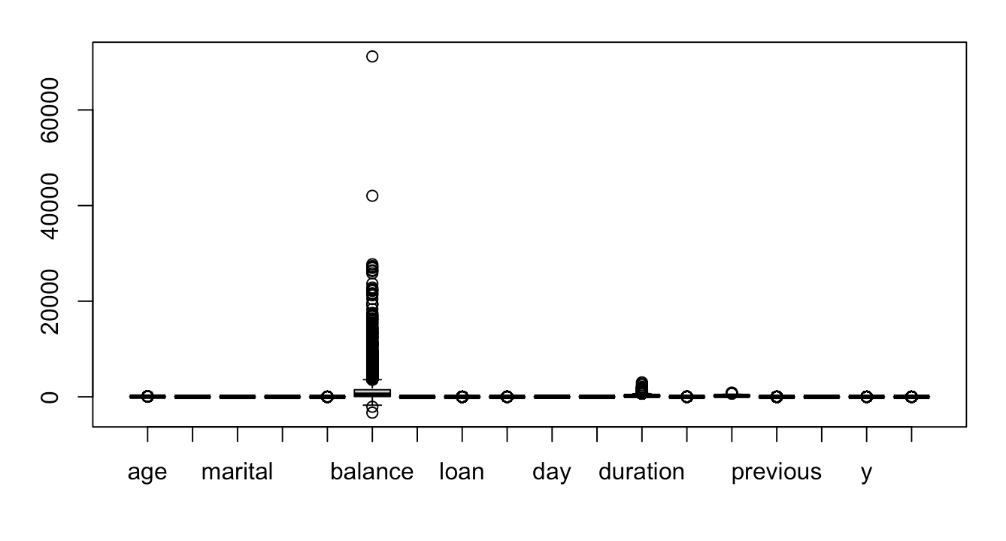
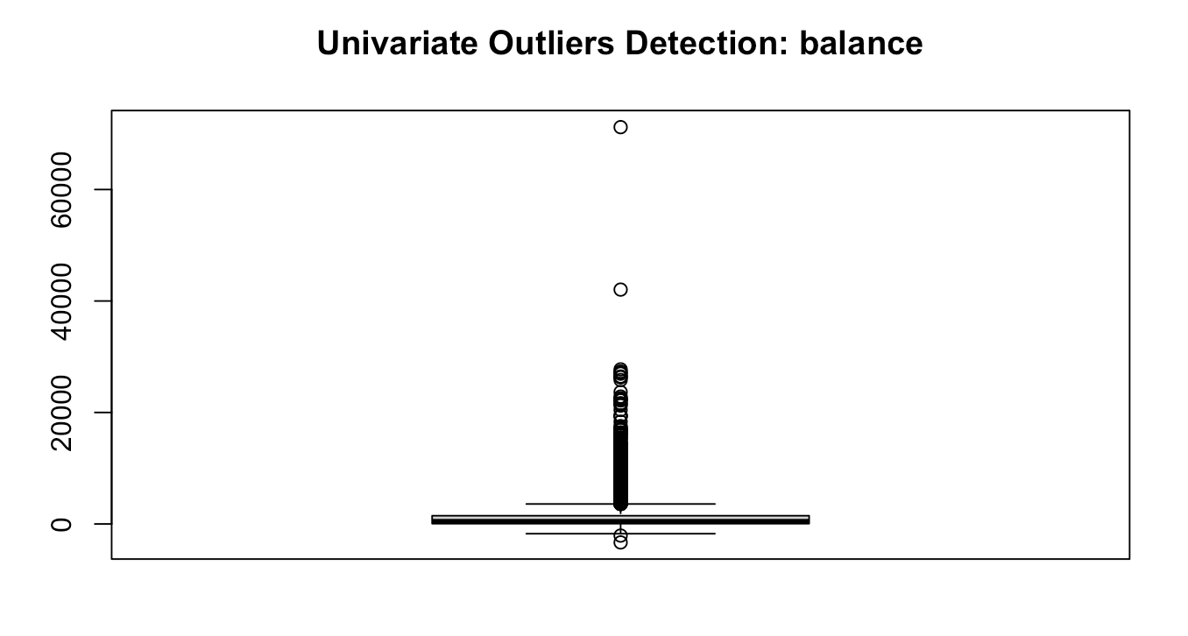
Univariate outliers

Slide 11
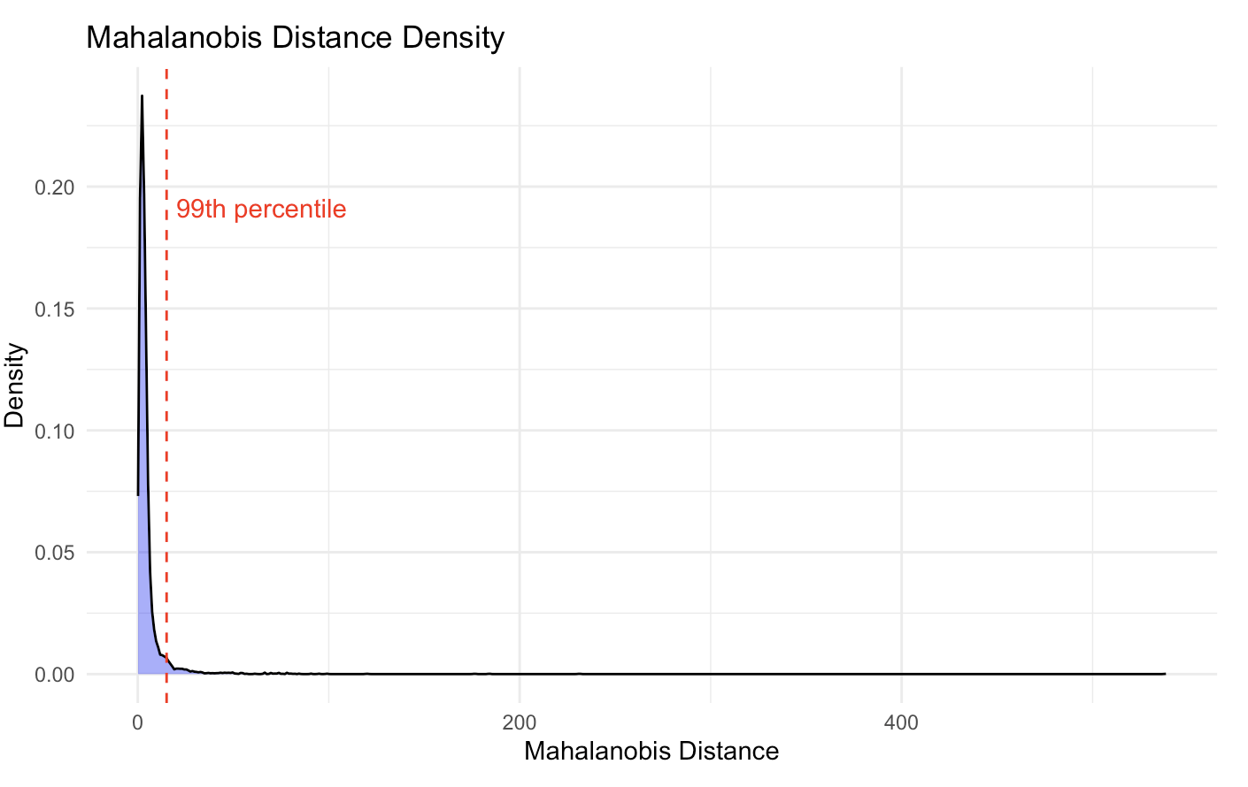
Mahalanobis distance

Slide 12
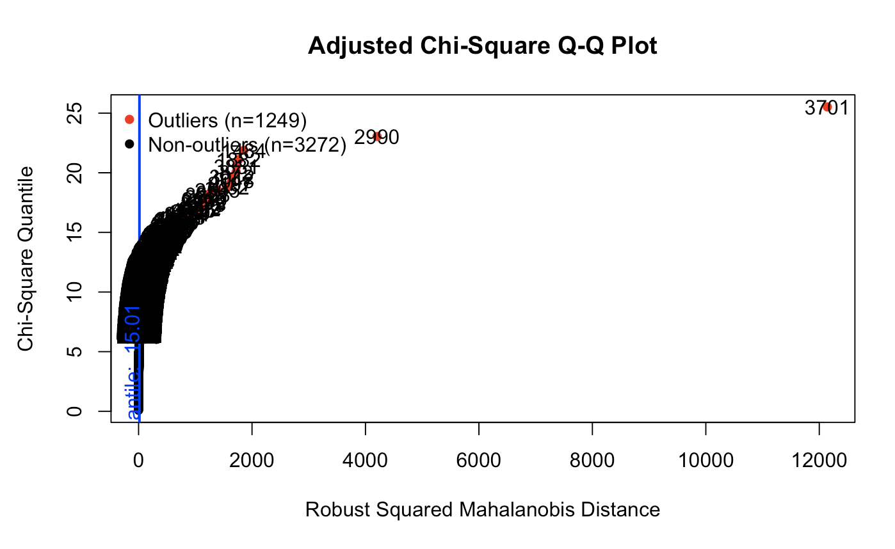
MVN Package

Slide 13
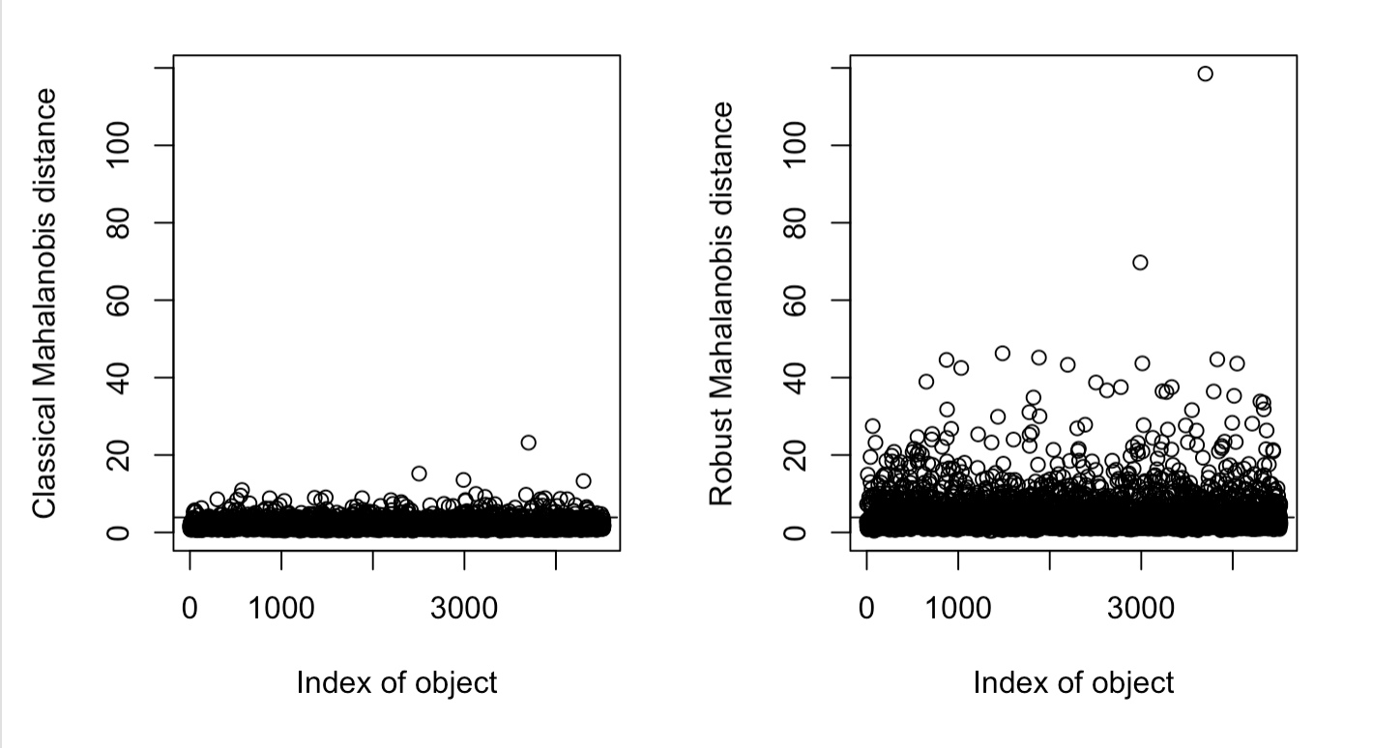
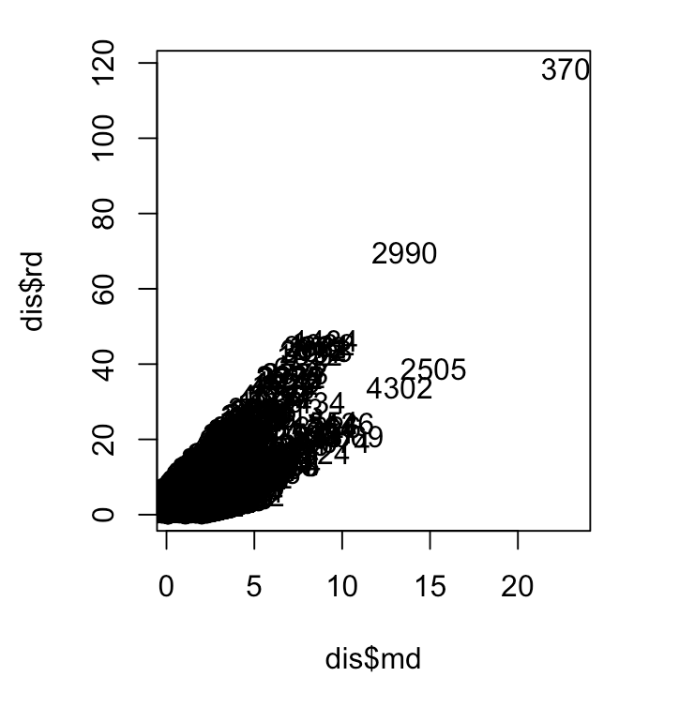
Moutlier function

Slide 14
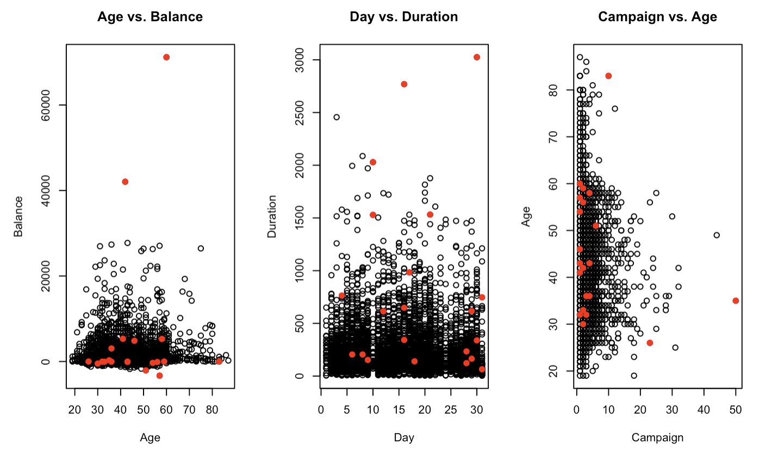
Density of local distances

Slide 15
3.Descriptive Analysis

Slide 16
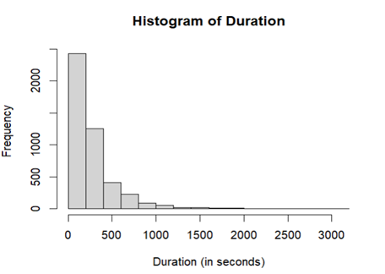
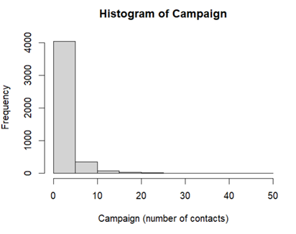
Univariate Analysis (numerical)

Slide 17
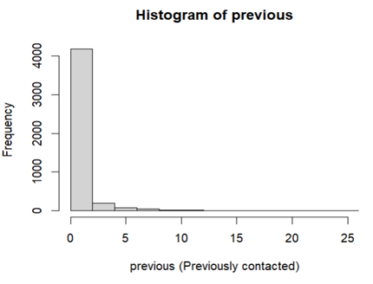
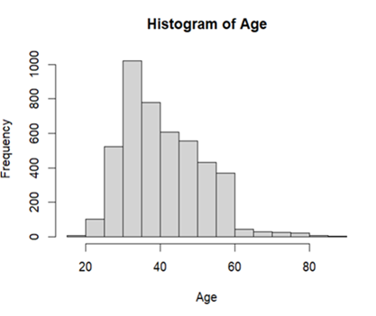
Univariate Analysis (numerical)

Slide 18
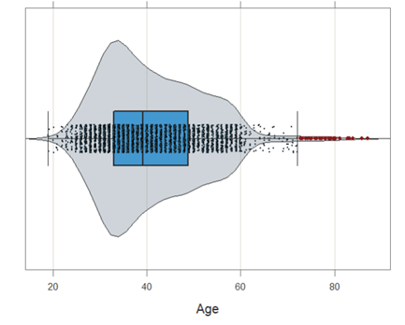
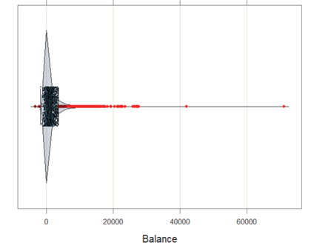
Univariate Analysis (numerical)

Slide 19
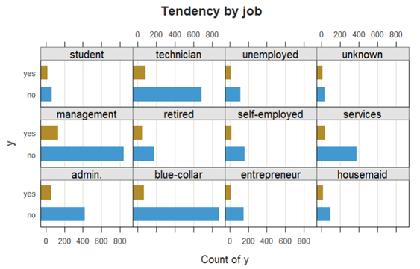
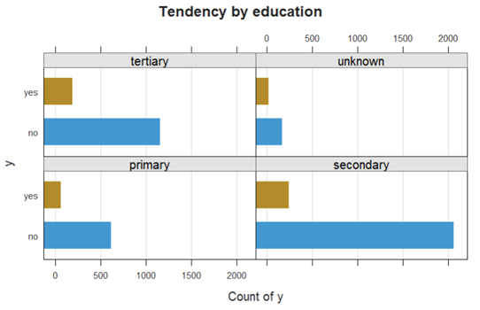
Analysis of categorical features

Slide 20
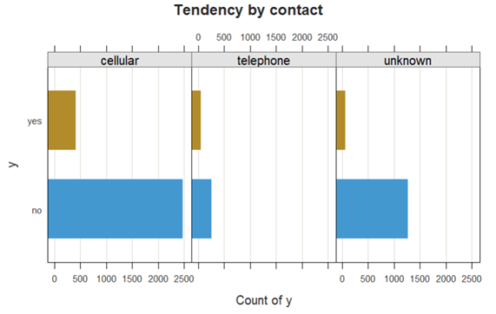
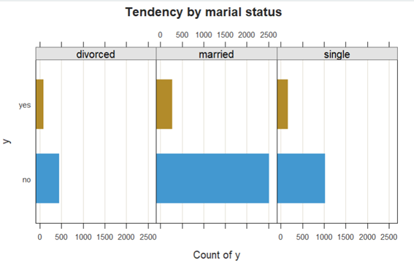
Analysis of categorical features
Tendency by marital status

Slide 21
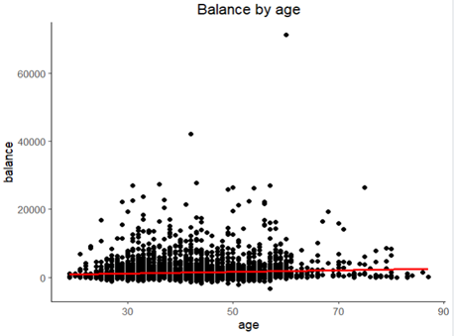
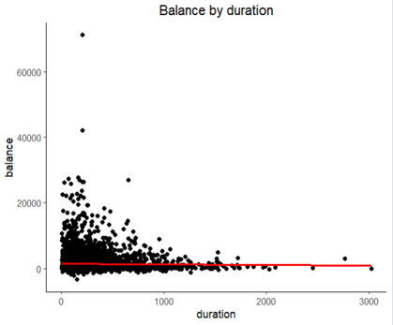
Bivariate Analysis

Slide 22
4.PCA Analysis

Slide 23
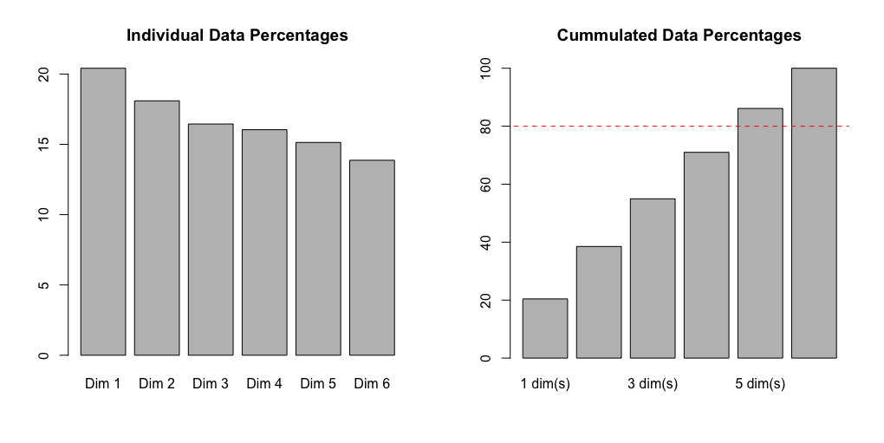
Choosing the number of dimensions

Slide 24
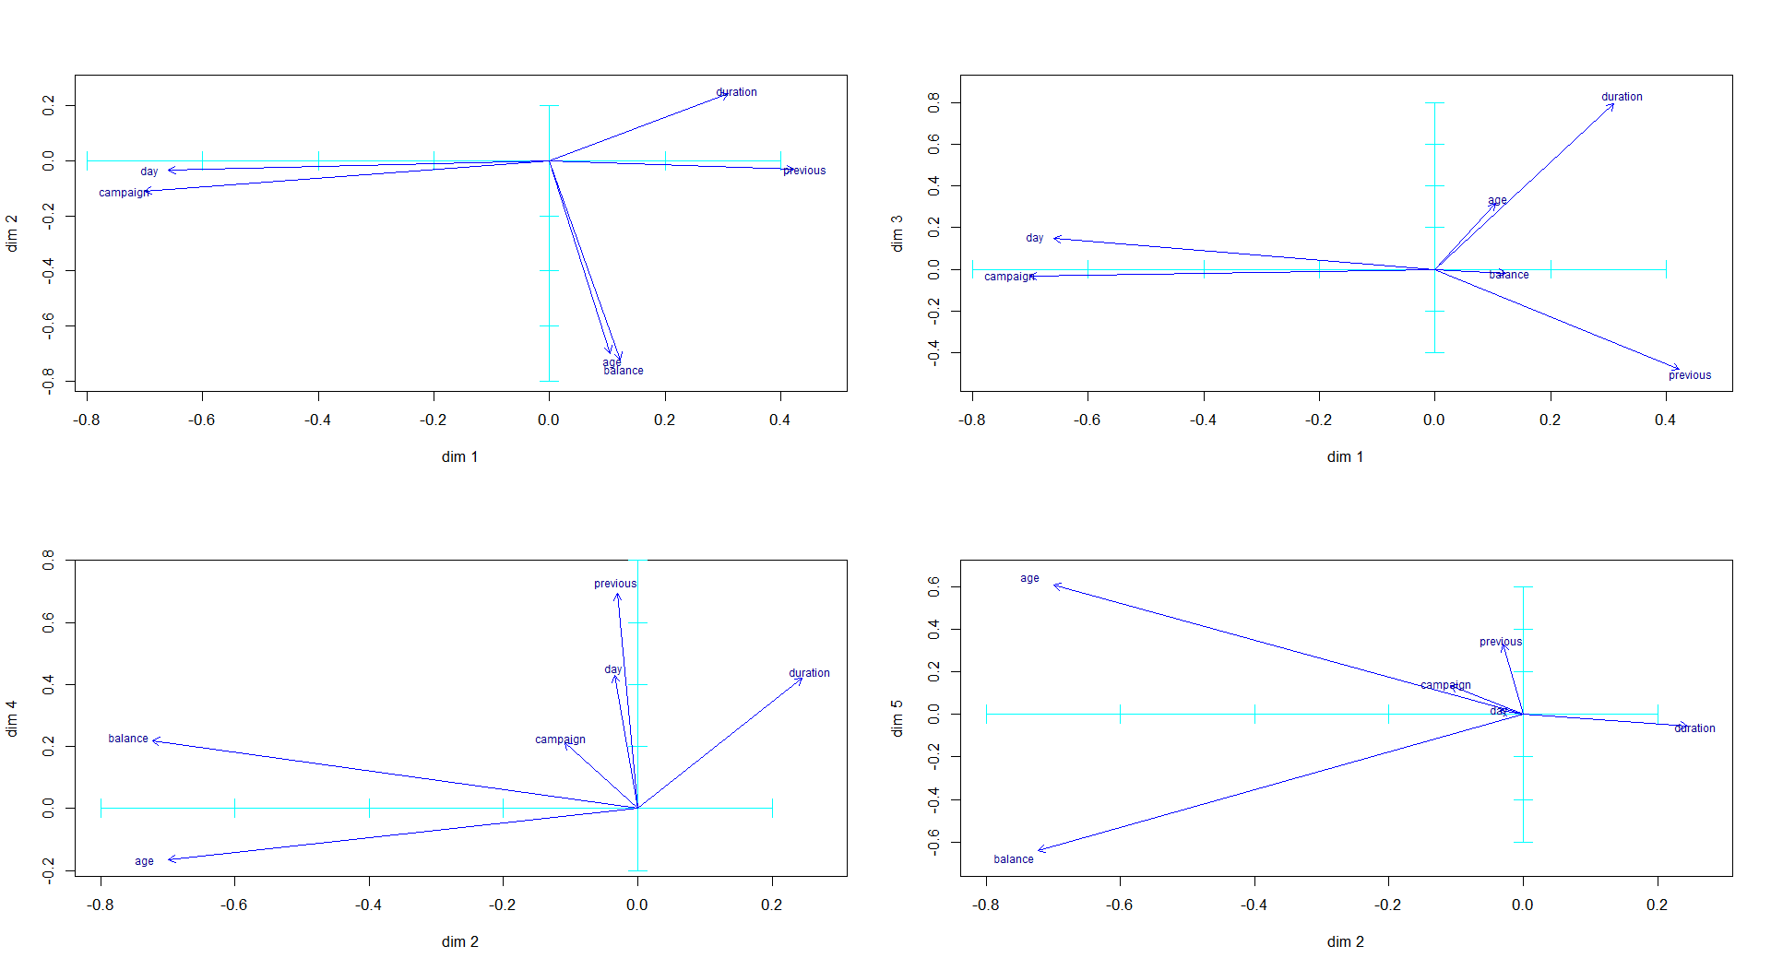
Projection of original variables

Slide 25
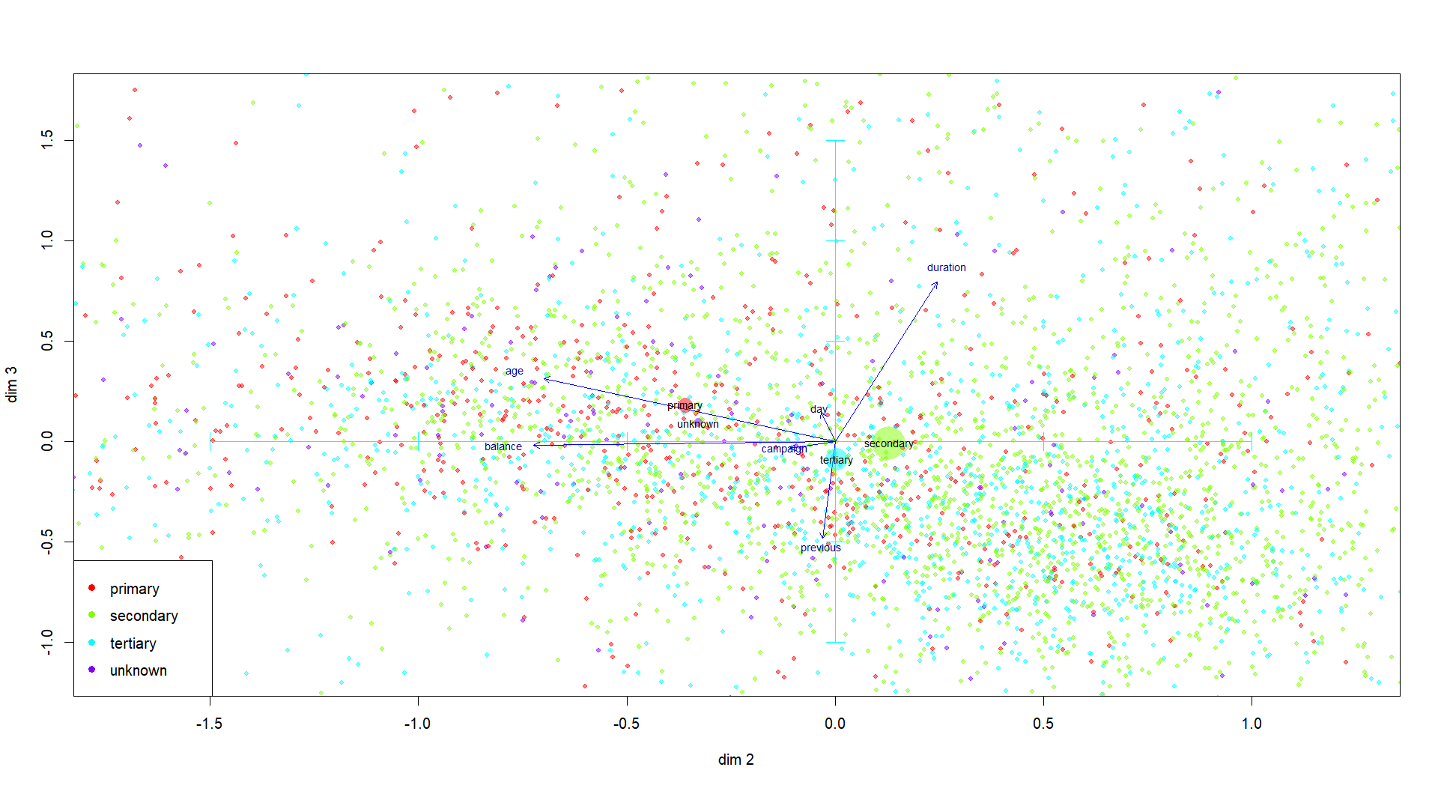
Education

Slide 26
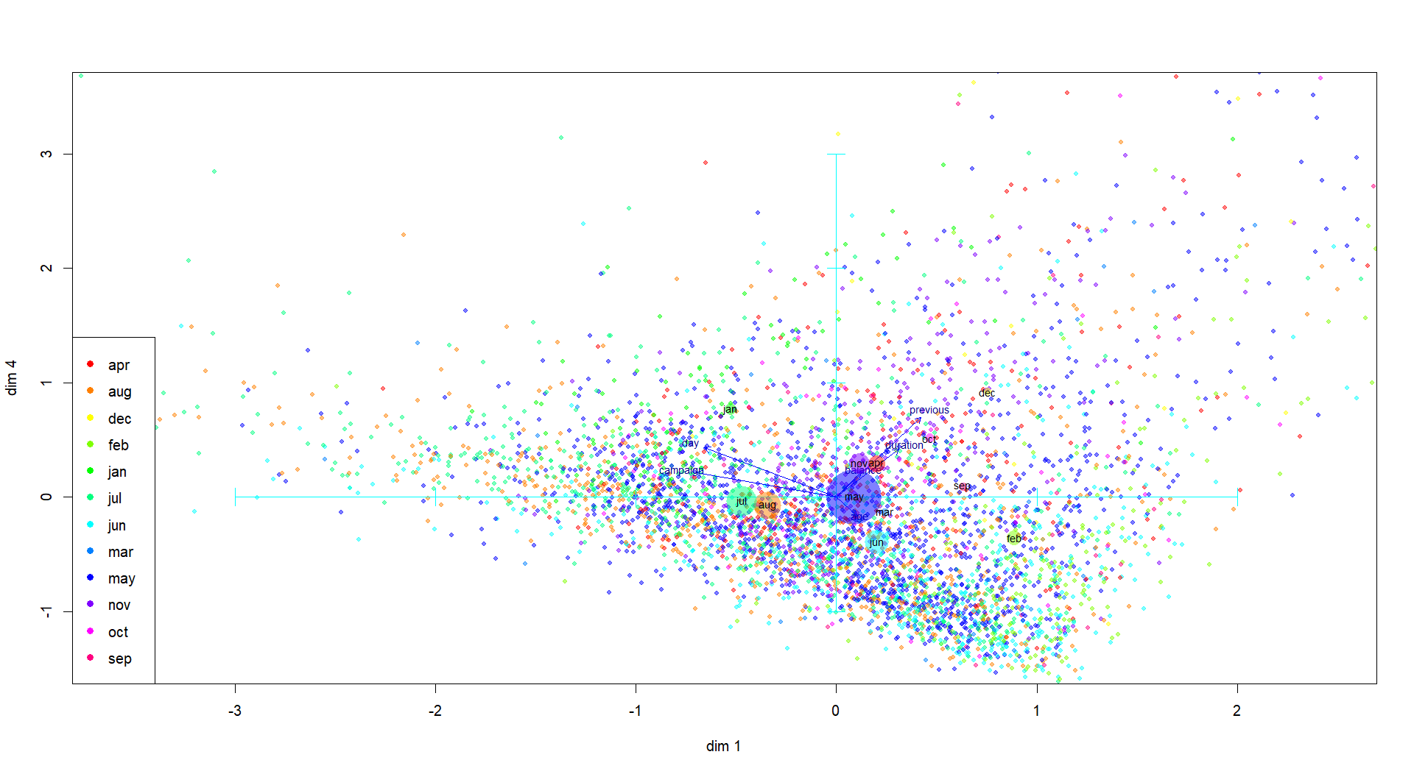
Months

Slide 27
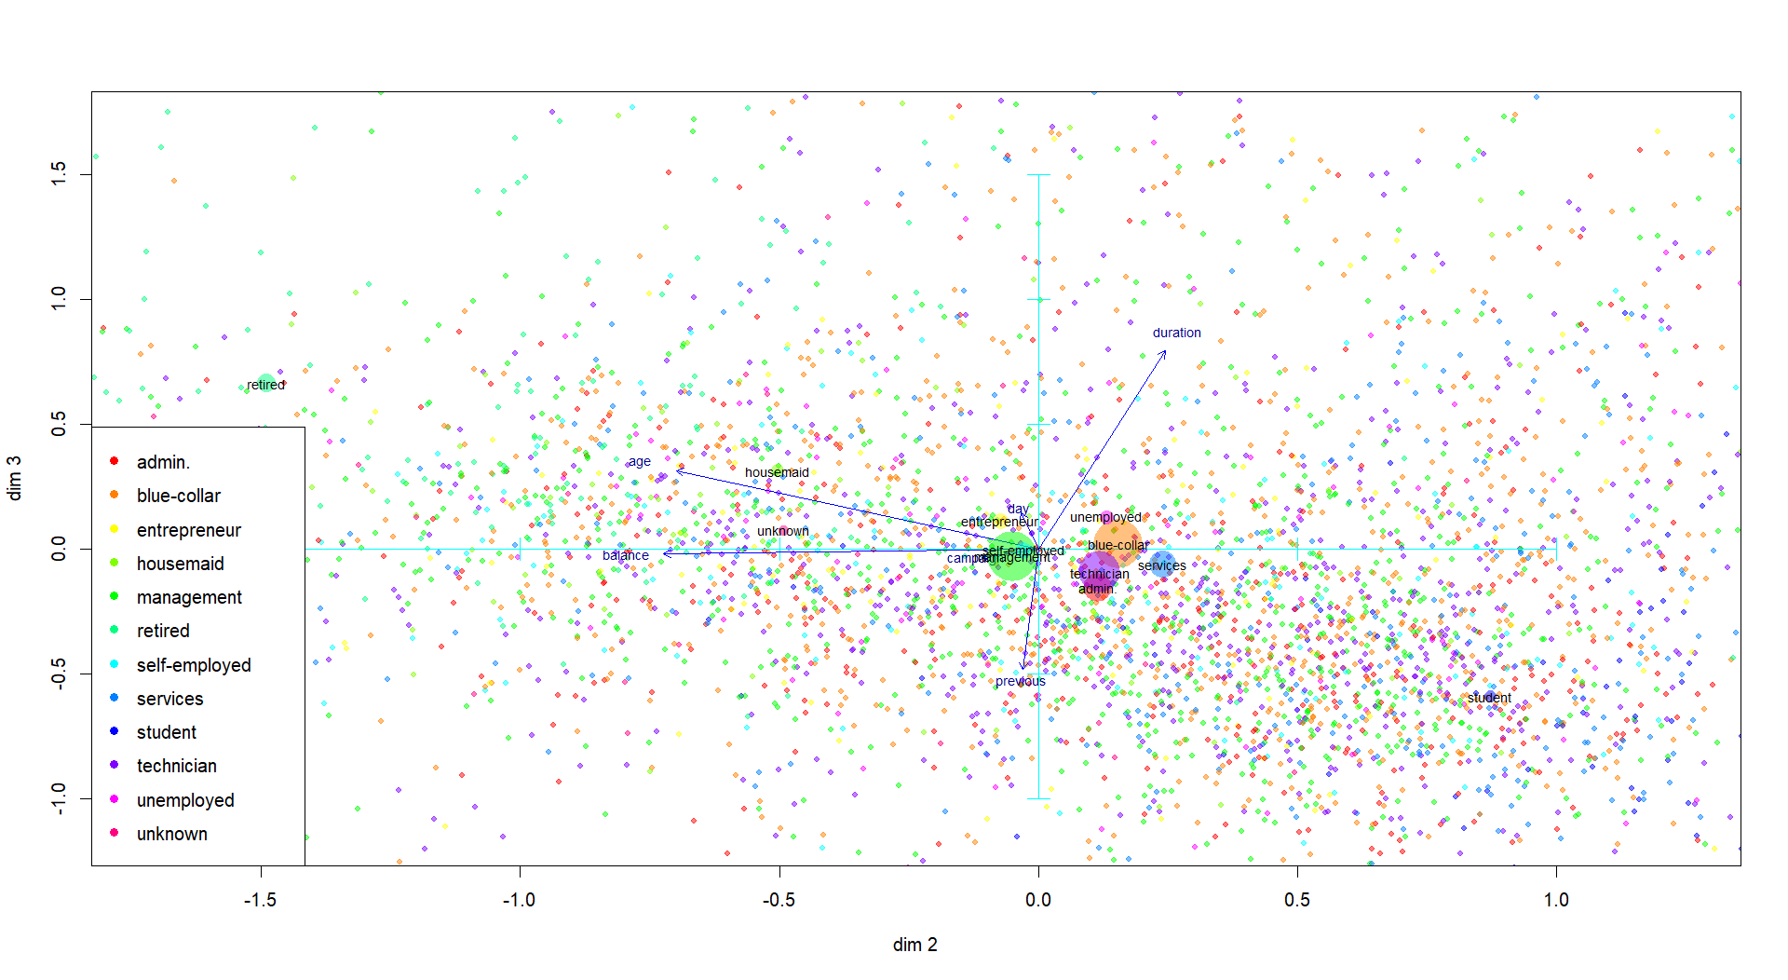
Profession

Slide 28
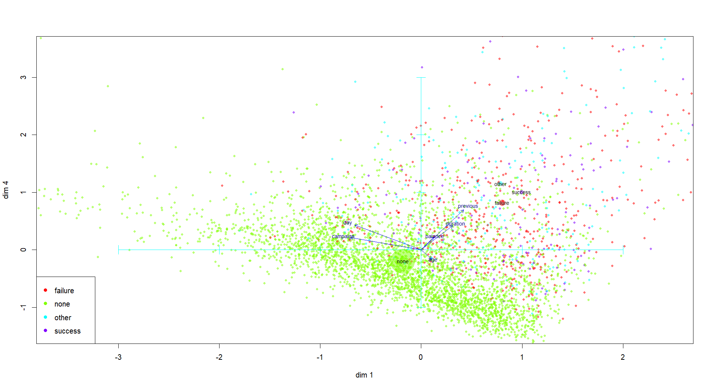
Outcome of the previous campaign

Slide 29
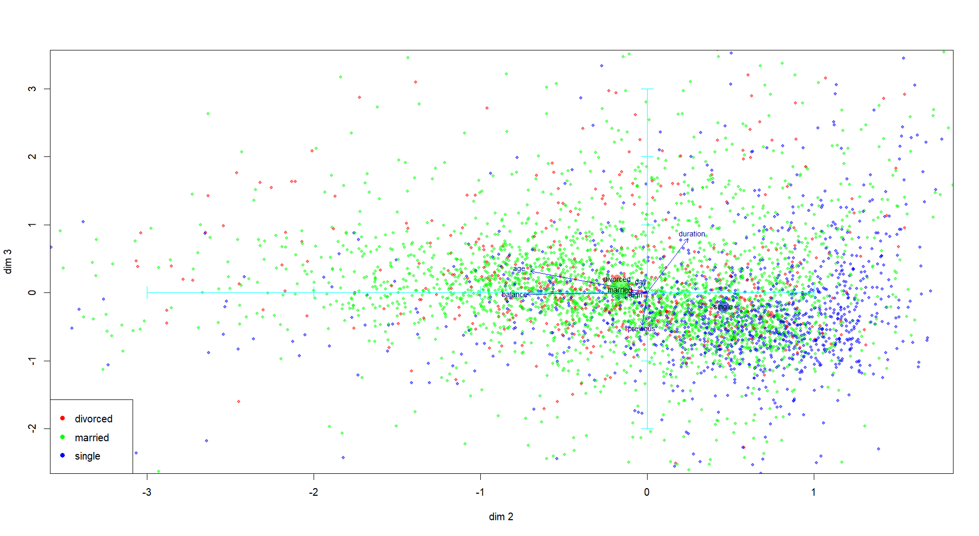
Marital status

Slide 30
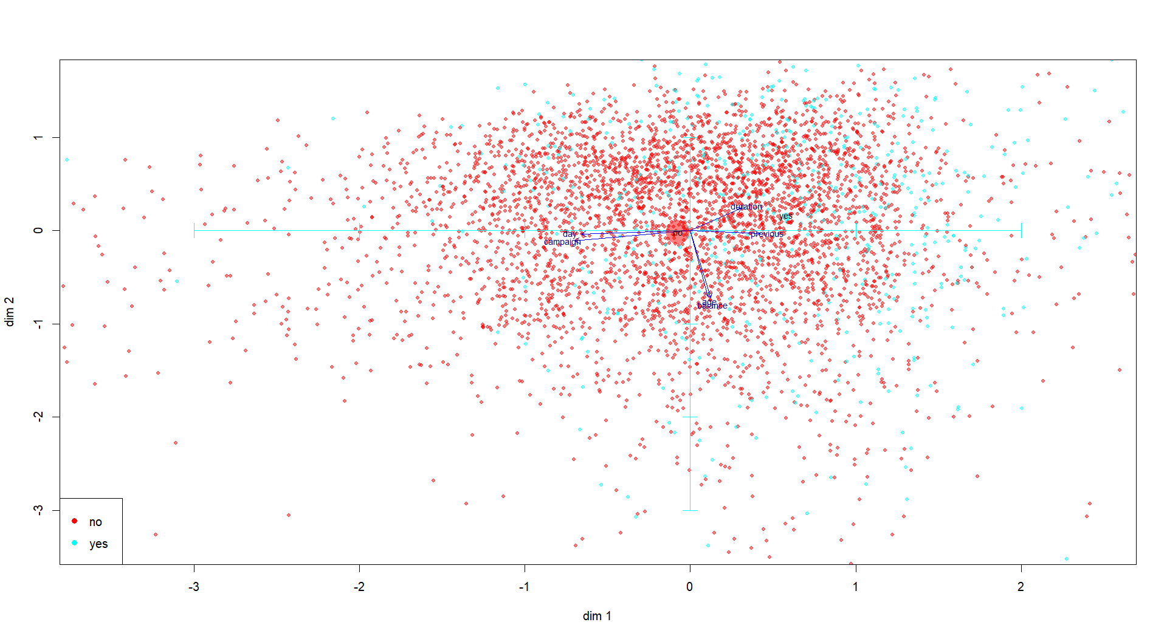
Has subscribed a term deposit

Slide 31
5.MCA Analysis

Slide 32
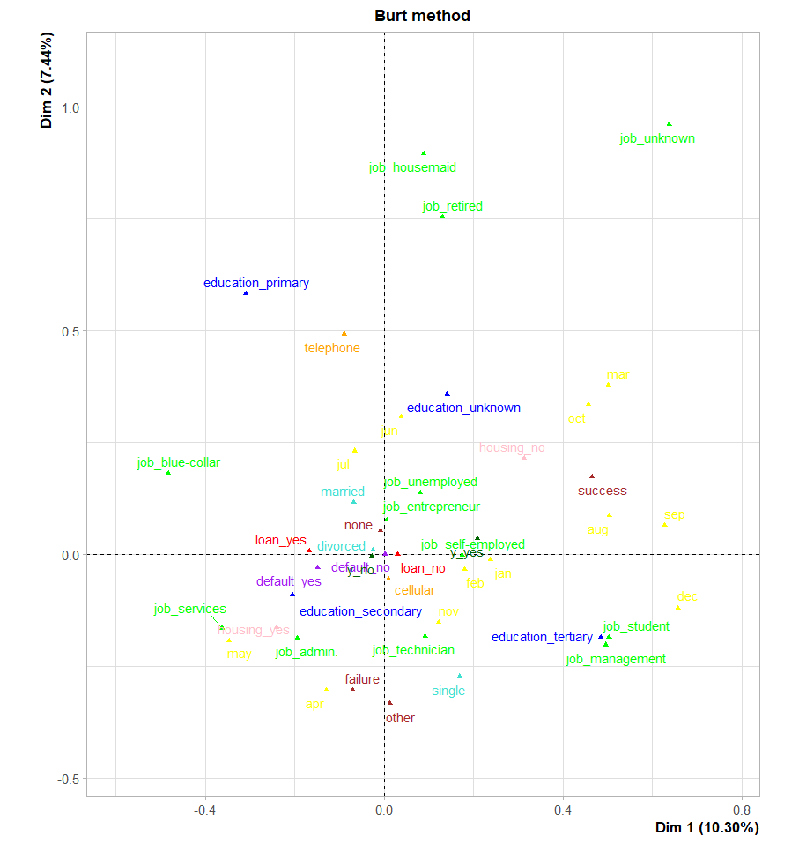
MCA plot
Most relevant categories and modalities
How are they grouped
Which give us the most insight for our analysis

Slide 33
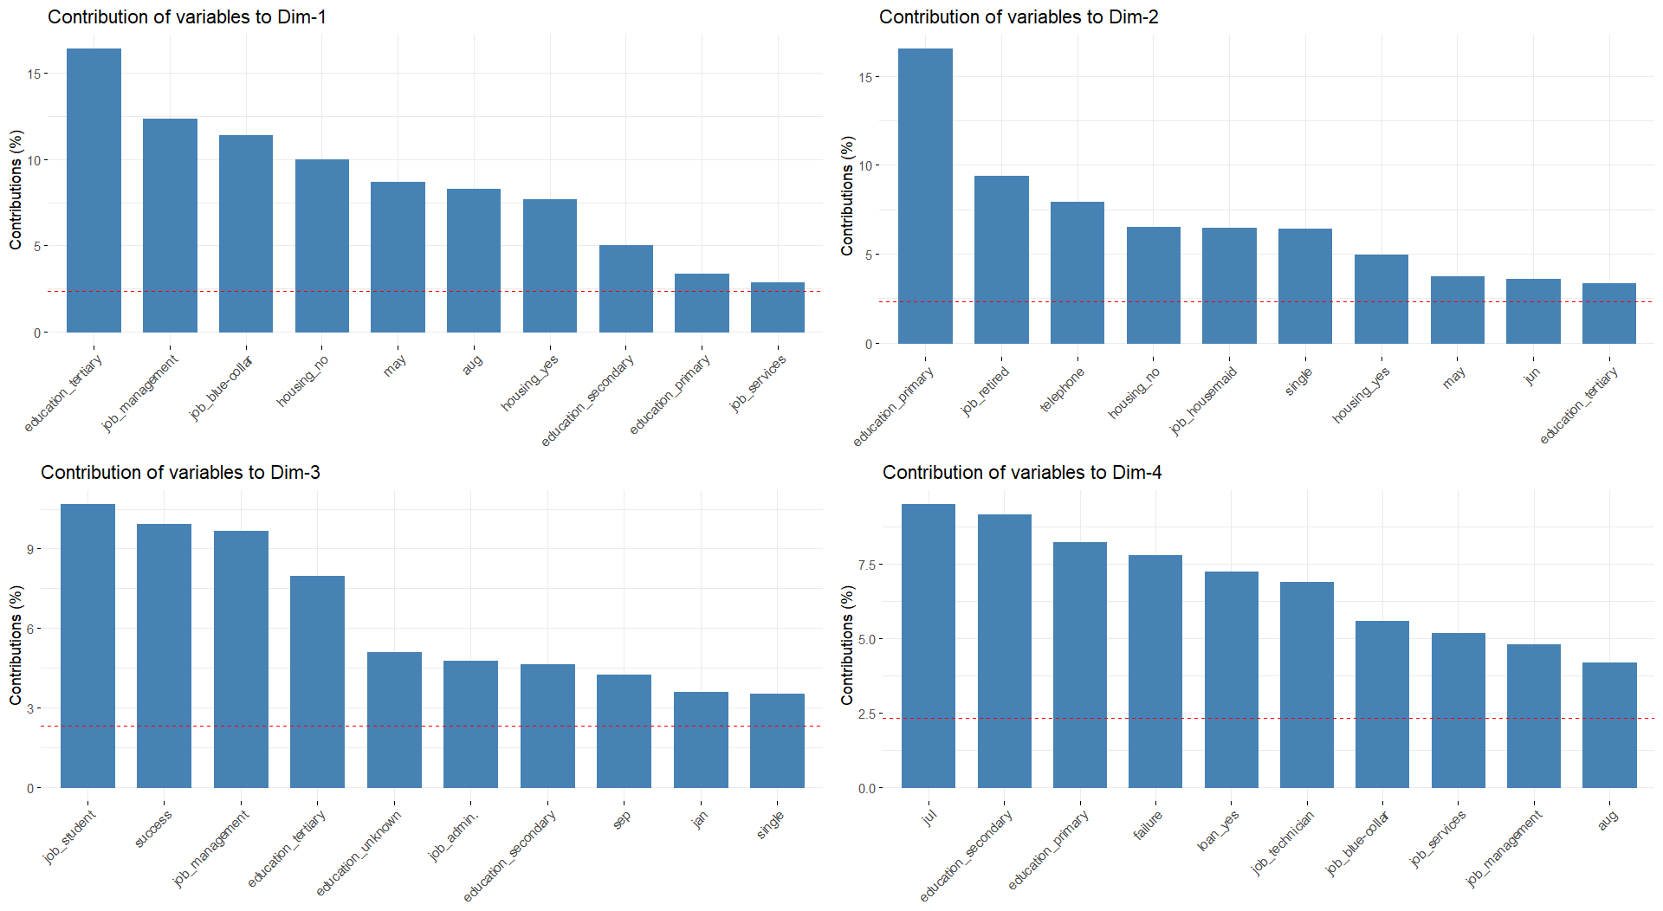
Contribution

Slide 34
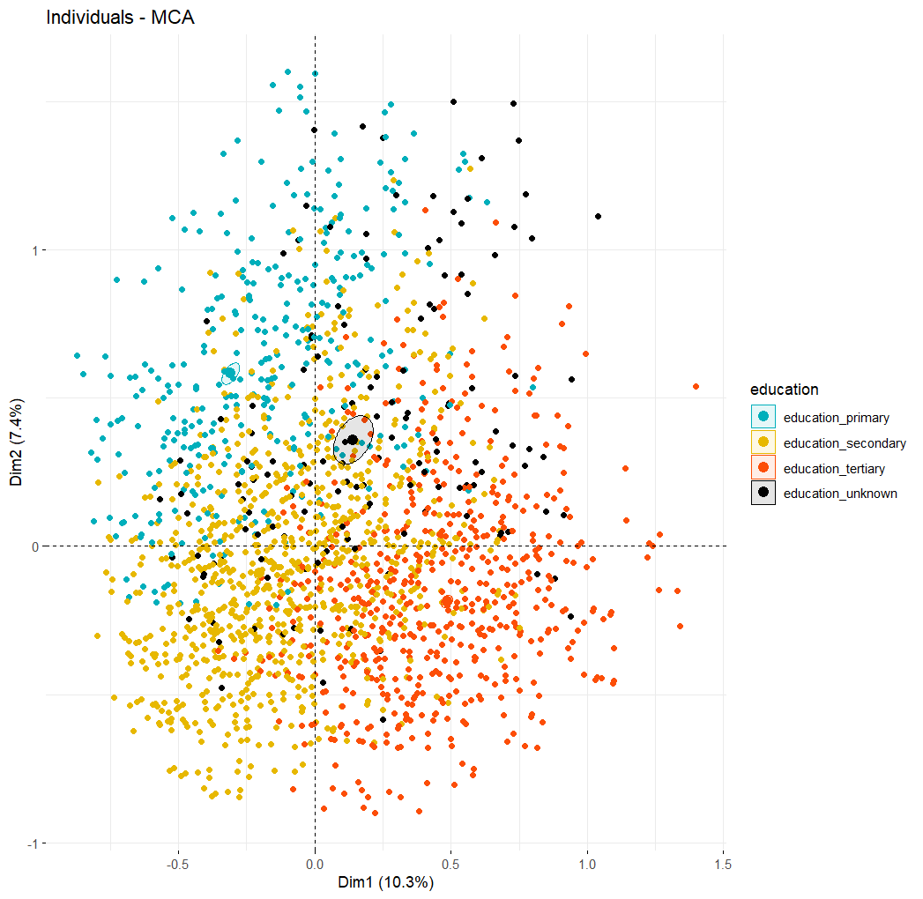
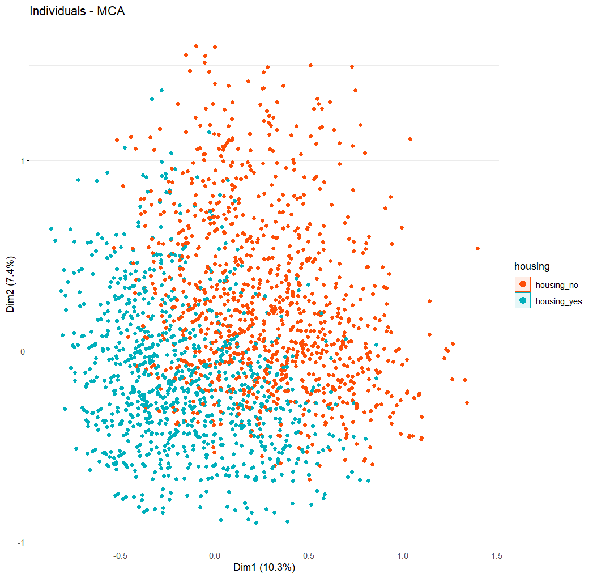
Modalities

Slide 35
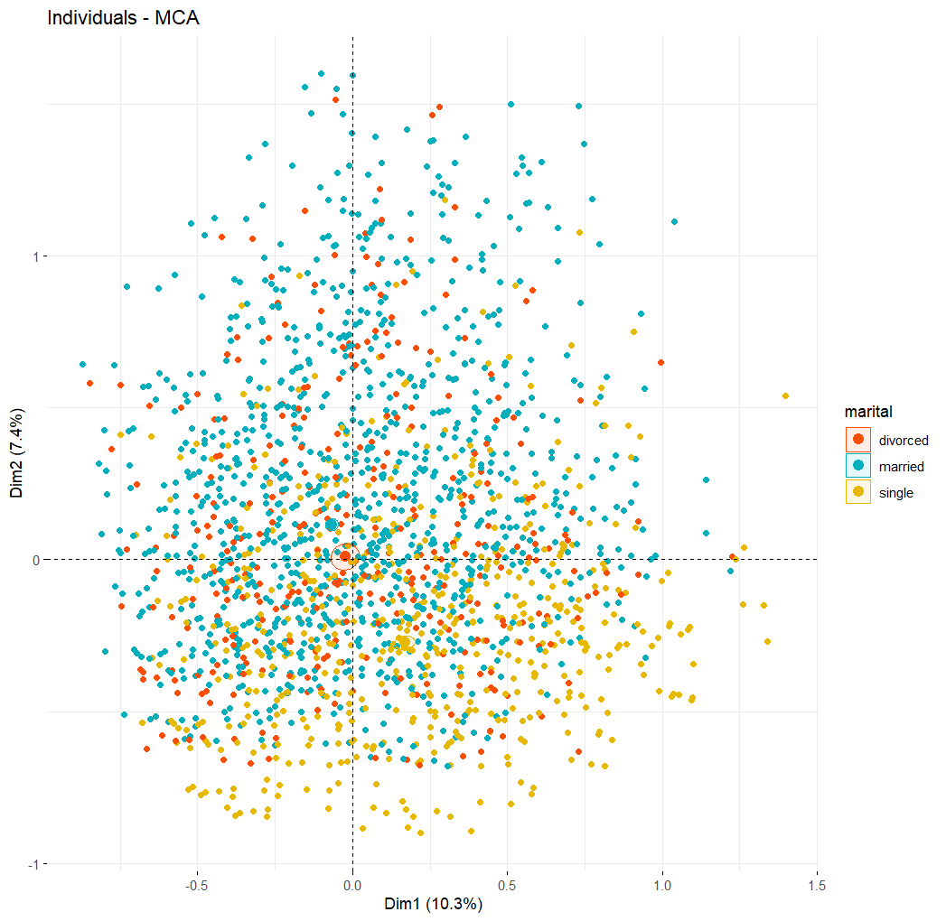
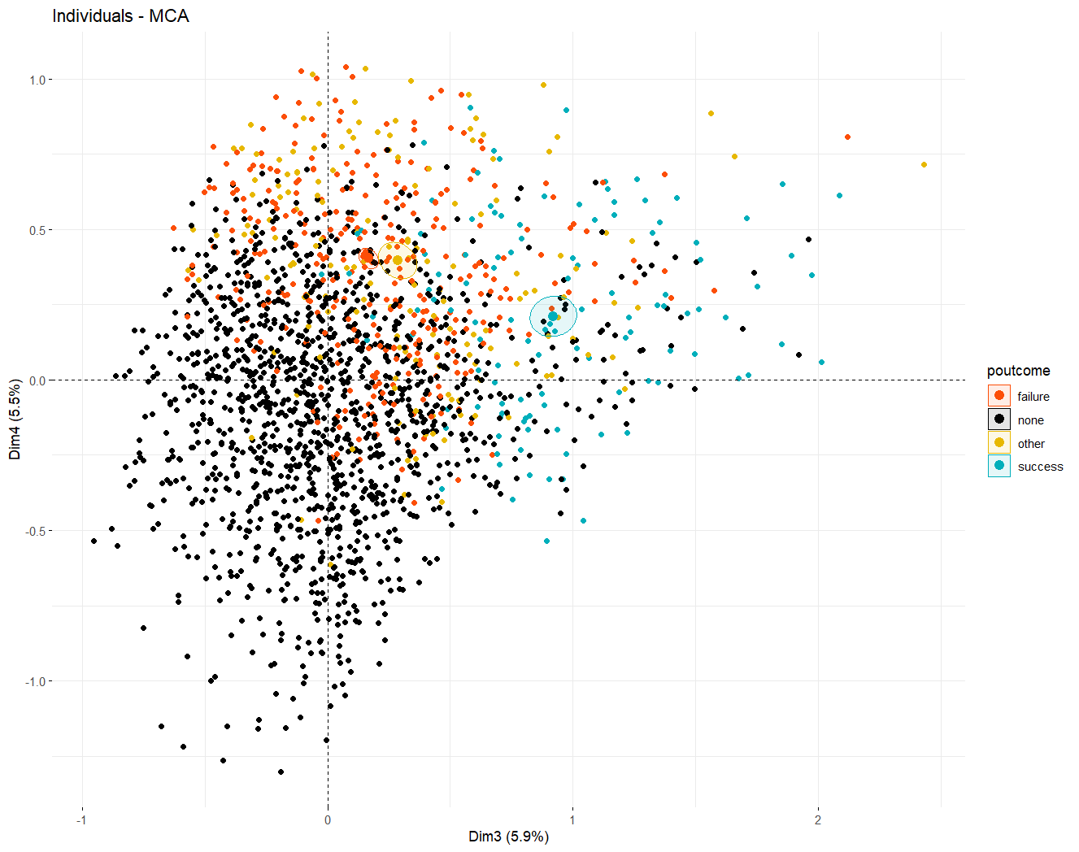
Modalities

Slide 36
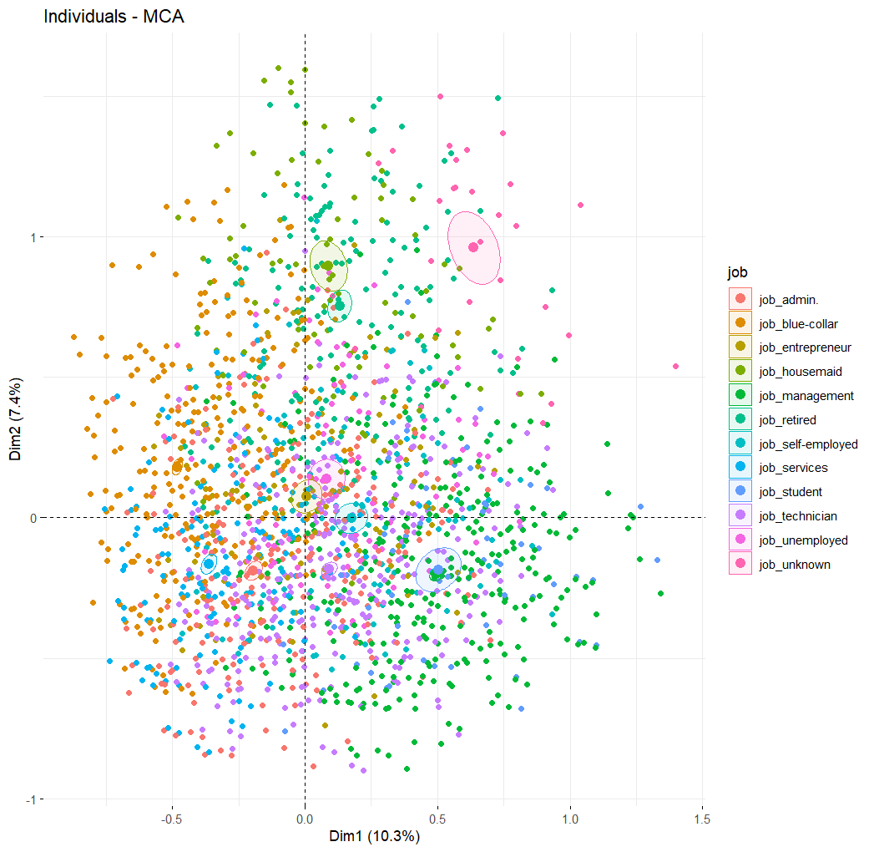
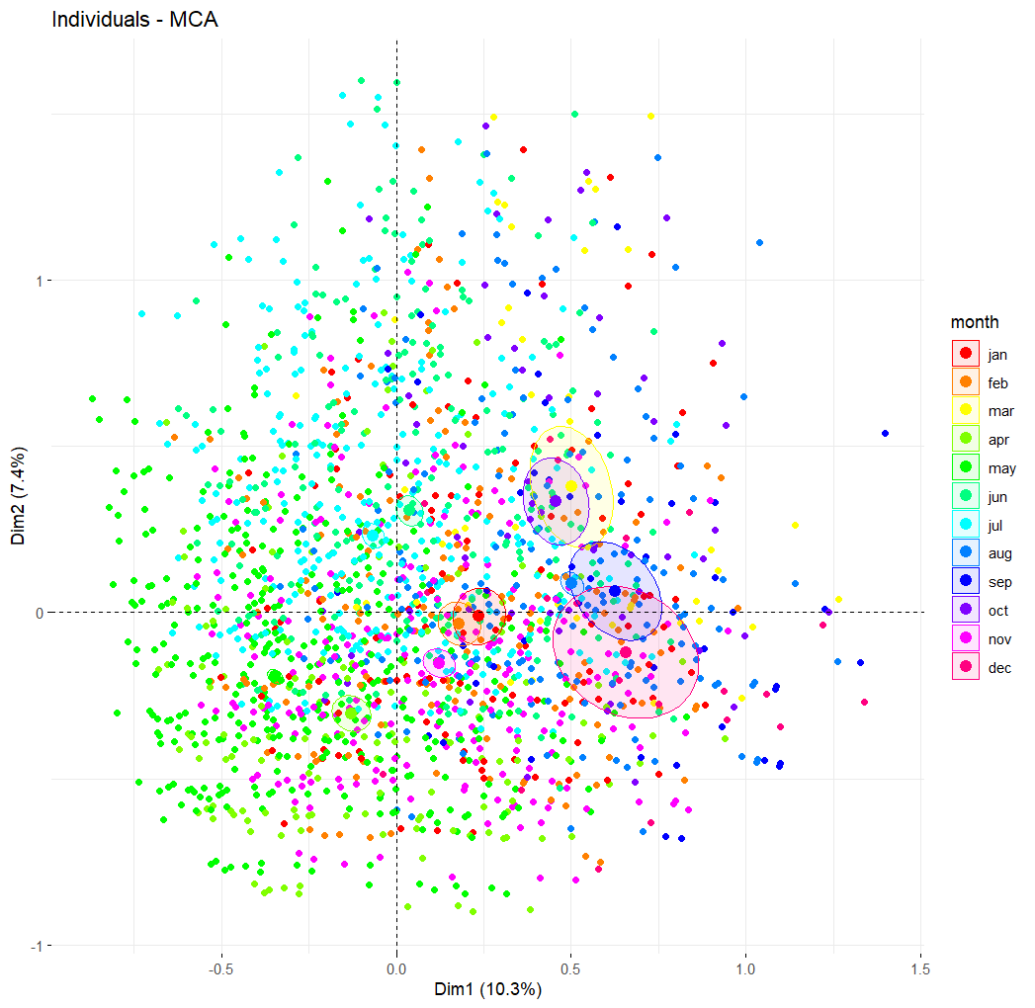
Modalities

Slide 37
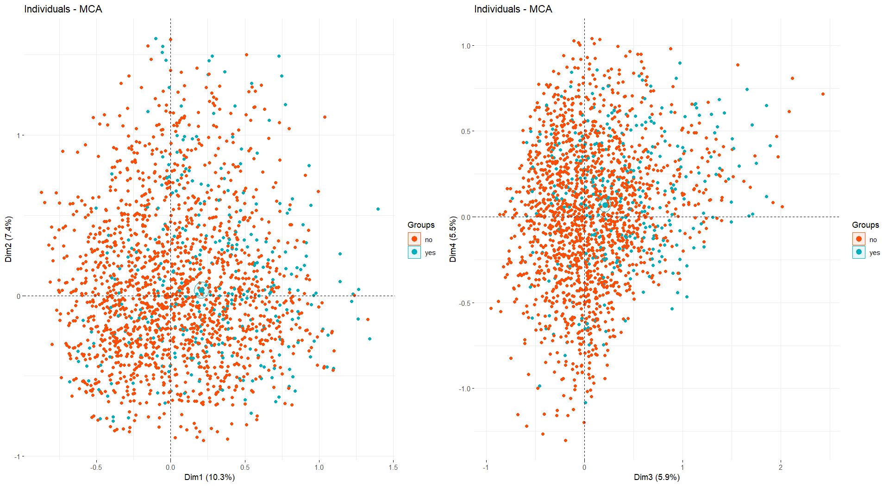
Has subscribed a term deposit

